Slide 1
What % of each risk group respond & fund? Renewal rates of pre-approved customers Fund and response rates for different industries by month? Most non-responsive industries Conversion by industry Seasonality

Slide 2
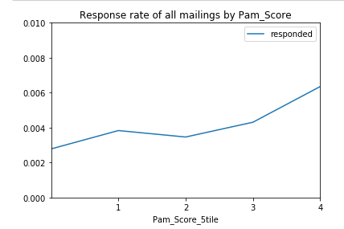
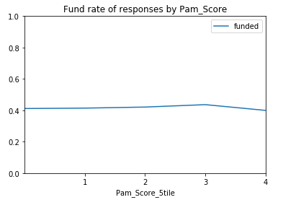
What % of each risk group respond & fund?
As PAM score increases (riskier), customer response increases.
PAM score has little effect on funding rate.

Slide 3
Renewal rates of pre-approved customers
Pre-Approved | Count | Average Seasonal Performance | Renewal Rate
False | 3029 | 138% | 67%
True | 775 | 158% | 66%
Pre-Approved generally perform better (as expected), however do not renew at different levels
- Better customers generally will have other options
- Worse customers less likely to get approved

Slide 4
Industry Grouping
7 industries identified from MCC descriptions
Industry | Times mailed (K) | % of total mailings | Response Rate
Auto | 316 | 11% | 0.27%
Food/Drink/Hotel | 734 | 25% | 0.66%
Beauty/Barbers | 229 | 8% | 0.46%
Medical/Dental/Vets | 210 | 7% | 0.19%
Professional Services | 258 | 9% | 0.26%
Retail | 563 | 19% | 0.42%
Industrial | 267 | 9% | 0.25%
Other | 389 | 13% | 0.31%
Total | 2,966 | 100% | 0.41%

Slide 5
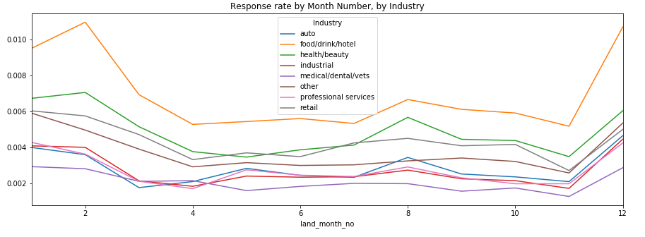
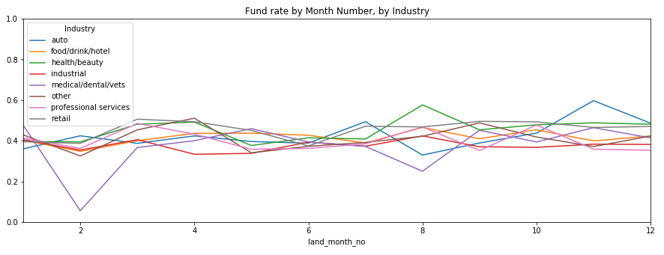
Fund and response rates for different industries by month
Clear spikes in response rate Dec-Feb for all industries, greater for Food/Drink/Hotel
Some spike in August for most industries
Industrial, Professional Services, Auto all behave fairly similarly
No trend in fund rate for industries

Slide 6
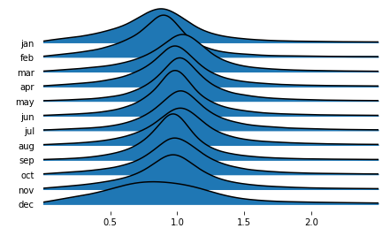
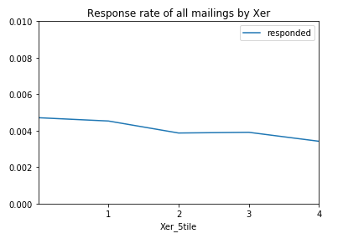
Seasonality
Using customers’ volume, we can calculate their busyness by month.
I.e. January busyness = (Average Jan volume) / (Average volume in other months)
Call this metric ‘Xer’ (multiplier)
Distribution of Xer by month
Dec-Feb is generally less busy for customers
Dec especially is a lot flatter – customers are more likely to be more or less busy than other months
There is correlation between business being quiet and response rate

